Slide 1
TAKE PART IN ORGANISED CANCER SCREENING PROGRAMMES
Messages for general public
#PrEvCan #CANCERCODE
The PrEvCan campaign was initiated by EONS and is run in association with key campaign partner, ESMO. More info: www.cancernurse.eu/prevcan

Slide 2
Insert logo of your organization
here
TAKE PART IN ORGANISED CANCER SCREENING PROGRAMMES
Take part in organised cancer screening programmes for:
Bowel cancer (men and women)
Breast cancer (women)
Cervical cancer (women)
#PrEvCan #CANCERCODE
The PrEvCan campaign was initiated by EONS and is run in association with key campaign partner, ESMO. More info: www.cancernurse.eu/prevcan

Slide 3
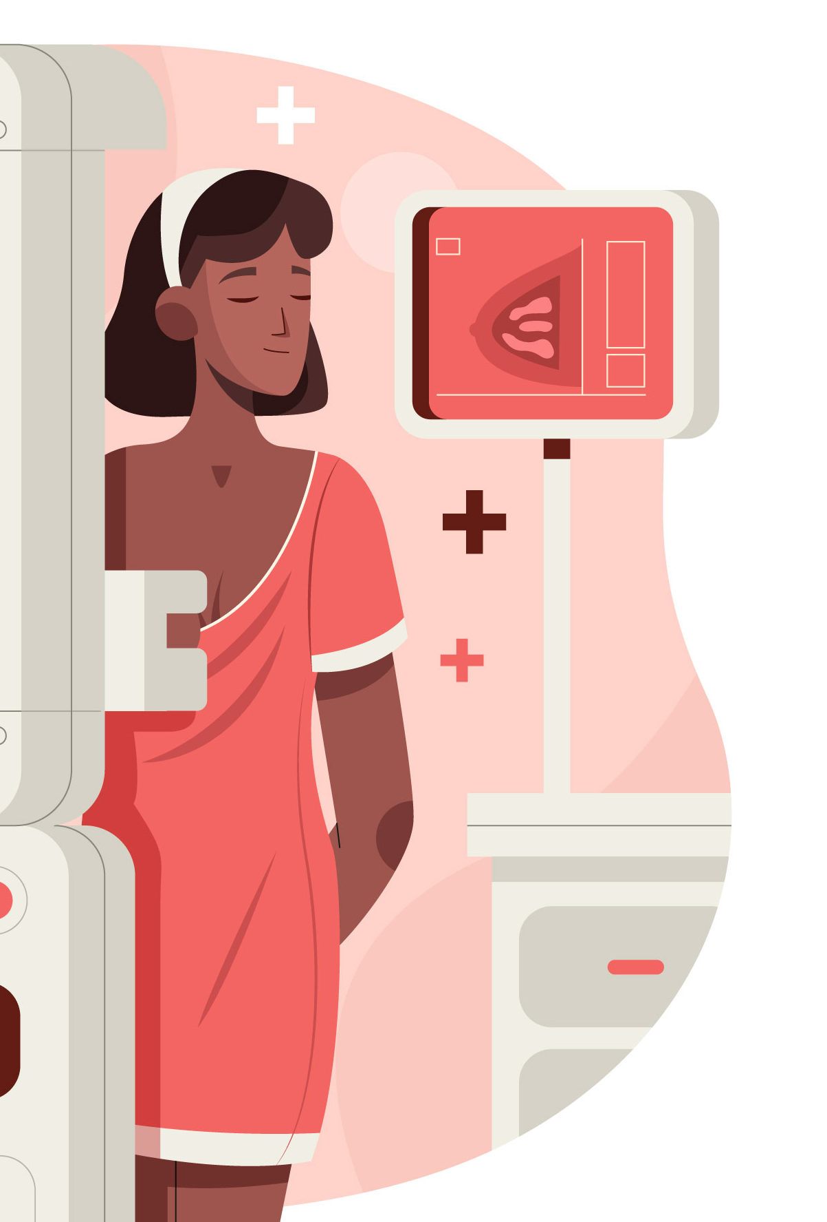
Insert logo of your organization
here
TAKE PART IN ORGANISED CANCER SCREENING PROGRAMMES
Cancer screening saves lives, always attend cancer screening, when invited
#PrEvCan #CANCERCODE
The PrEvCan campaign was initiated by EONS and is run in association with key campaign partner, ESMO. More info: www.cancernurse.eu/prevcan

Slide 4
Insert logo of your organization
here
TAKE PART IN ORGANISED CANCER SCREENING PROGRAMMES
Early detection of cancer greatly increases the chances for successful outcome
#PrEvCan #CANCERCODE
The PrEvCan campaign was initiated by EONS and is run in association with key campaign partner, ESMO. More info: www.cancernurse.eu/prevcan

Slide 5
TAKE PART IN ORGANISED CANCER SCREENING PROGRAMMES
Messages for healthcare professionals
#PrEvCan #CANCERCODE
The PrEvCan campaign was initiated by EONS and is run in association with key campaign partner, ESMO. More info: www.cancernurse.eu/prevcan

Slide 6
Insert logo of your organization
here
TAKE PART IN ORGANISED CANCER SCREENING PROGRAMMES
Always ask your patients if they attended available screening programs. If not, person-centered support, including involving their significant other may increase the likelihood of attending!
#PrEvCan #CANCERCODE
The PrEvCan campaign was initiated by EONS and is run in association with key campaign partner, ESMO. More info: www.cancernurse.eu/prevcan

Slide 7
Insert logo of your organization
here
TAKE PART IN ORGANISED CANCER SCREENING PROGRAMMES
Breast, cervical and bowel cancer screening should be available for the target population across Europe. New screening programs for other types of cancer need to be implemented and evaluated to reduce the cancer burden across Europe.
#PrEvCan #CANCERCODE
The PrEvCan campaign was initiated by EONS and is run in association with key campaign partner, ESMO. More info: www.cancernurse.eu/prevcan

Slide 8
Insert logo of your organization
here
TAKE PART IN ORGANISED CANCER SCREENING PROGRAMMES
Paste your photo
Customized message
#PrEvCan #CANCERCODE
The PrEvCan campaign was initiated by EONS and is run in association with key campaign partner, ESMO. More info: www.cancernurse.eu/prevcan

